Slide 1
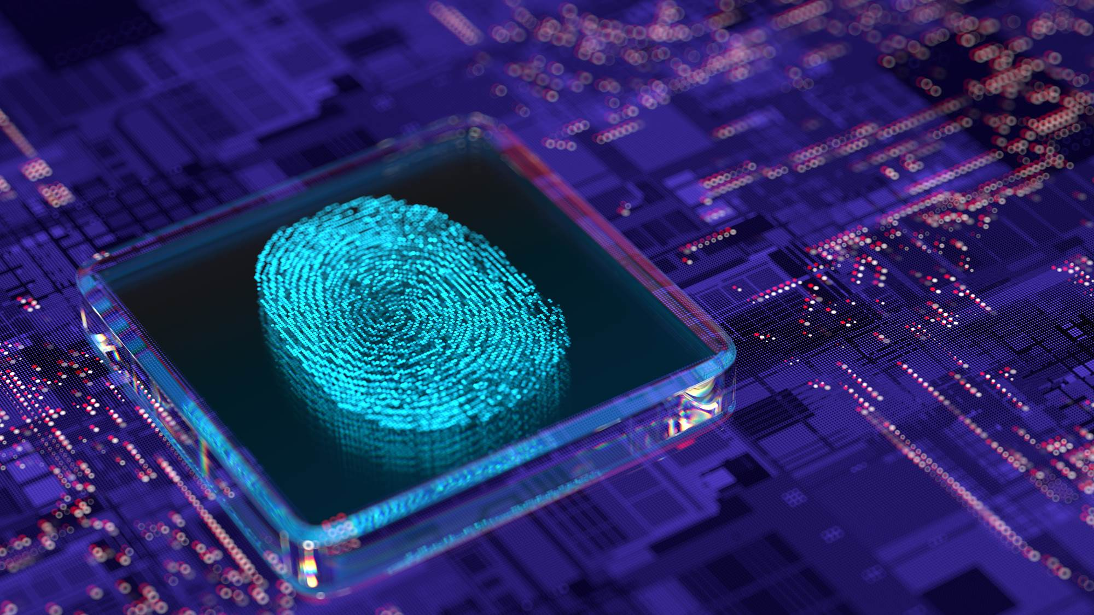

Implementation & Realization of Post-Quantum Cryptography (PQC)​
Fachtagung Cyber Security für kritische Infrastrukturen
Dr. Fabio Banfi
Zühlke © 2025
Notes:
Alex

Slide 2


Zühlke expertise
A partner for your Transformation
Guiding you step-by-step
through transformation
Creating seamless customer
and product experience
Bringing Transformation to life by closing the gap between technology, strategy and innovation.
Digital Consulting
Digital Experience
Building data-driven and
AI-enabled organisations
Developing sustainable and
scalable products
Data & AI
Bringing
Transformation
to life
Cloud & DevOps
Converting ideas into market-ready devices
Devices
Low-Code
Sustainability
Shortening time to value
Forming cyber resilience with sustainable defence
Cyber Security
Managed Services
Software Excellence
Constructing modern software architecture and ecosystems at scale
Operating and protecting your digital assets

Slide 3


About Zühlke
Bulgaria
Sofia
Austria Vienna
Germany Frankfurt
Hamburg
Hannover
Munich
Stuttgart
Portugal Porto
Zühlke is a globally operating
Swiss Information Technology company & digital transformation partner.
Switzerland Bern Zürich
Great Britain Edinburgh London Manchester
Serbia Belgrad
We combine customer-centered experience with technological excellence and business innovation. Together with our customers, we develop outstanding solutions that empower them in a long run.
Hong Kong
Hong Kong
Singapore Singapore
Vietnam Ho Chi Minh City
Founded in 1968
17 locations in 10 countries
1,900 employees worldwide
The Zühlke Group is owned by partners
Certifications: ISO 9001, ISO 13485, ISO 27001
We put data at the heart of everything we do
Focus on sustainability: climate protection and health promotion
Implementation & Realization of PQC
25.09.2025
| 3

Slide 4
Current State of Quantum Computing
Notes:
Fabio

Slide 5
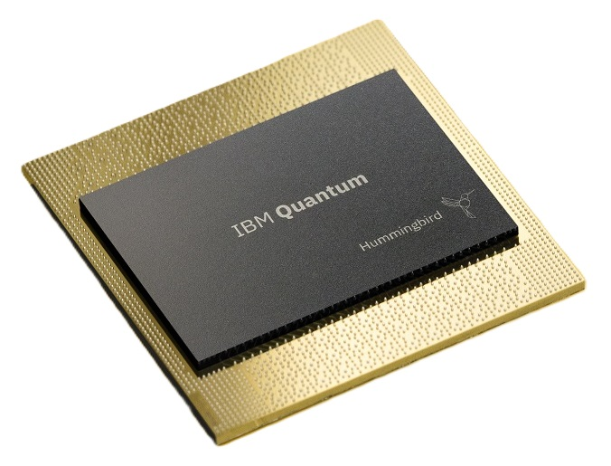
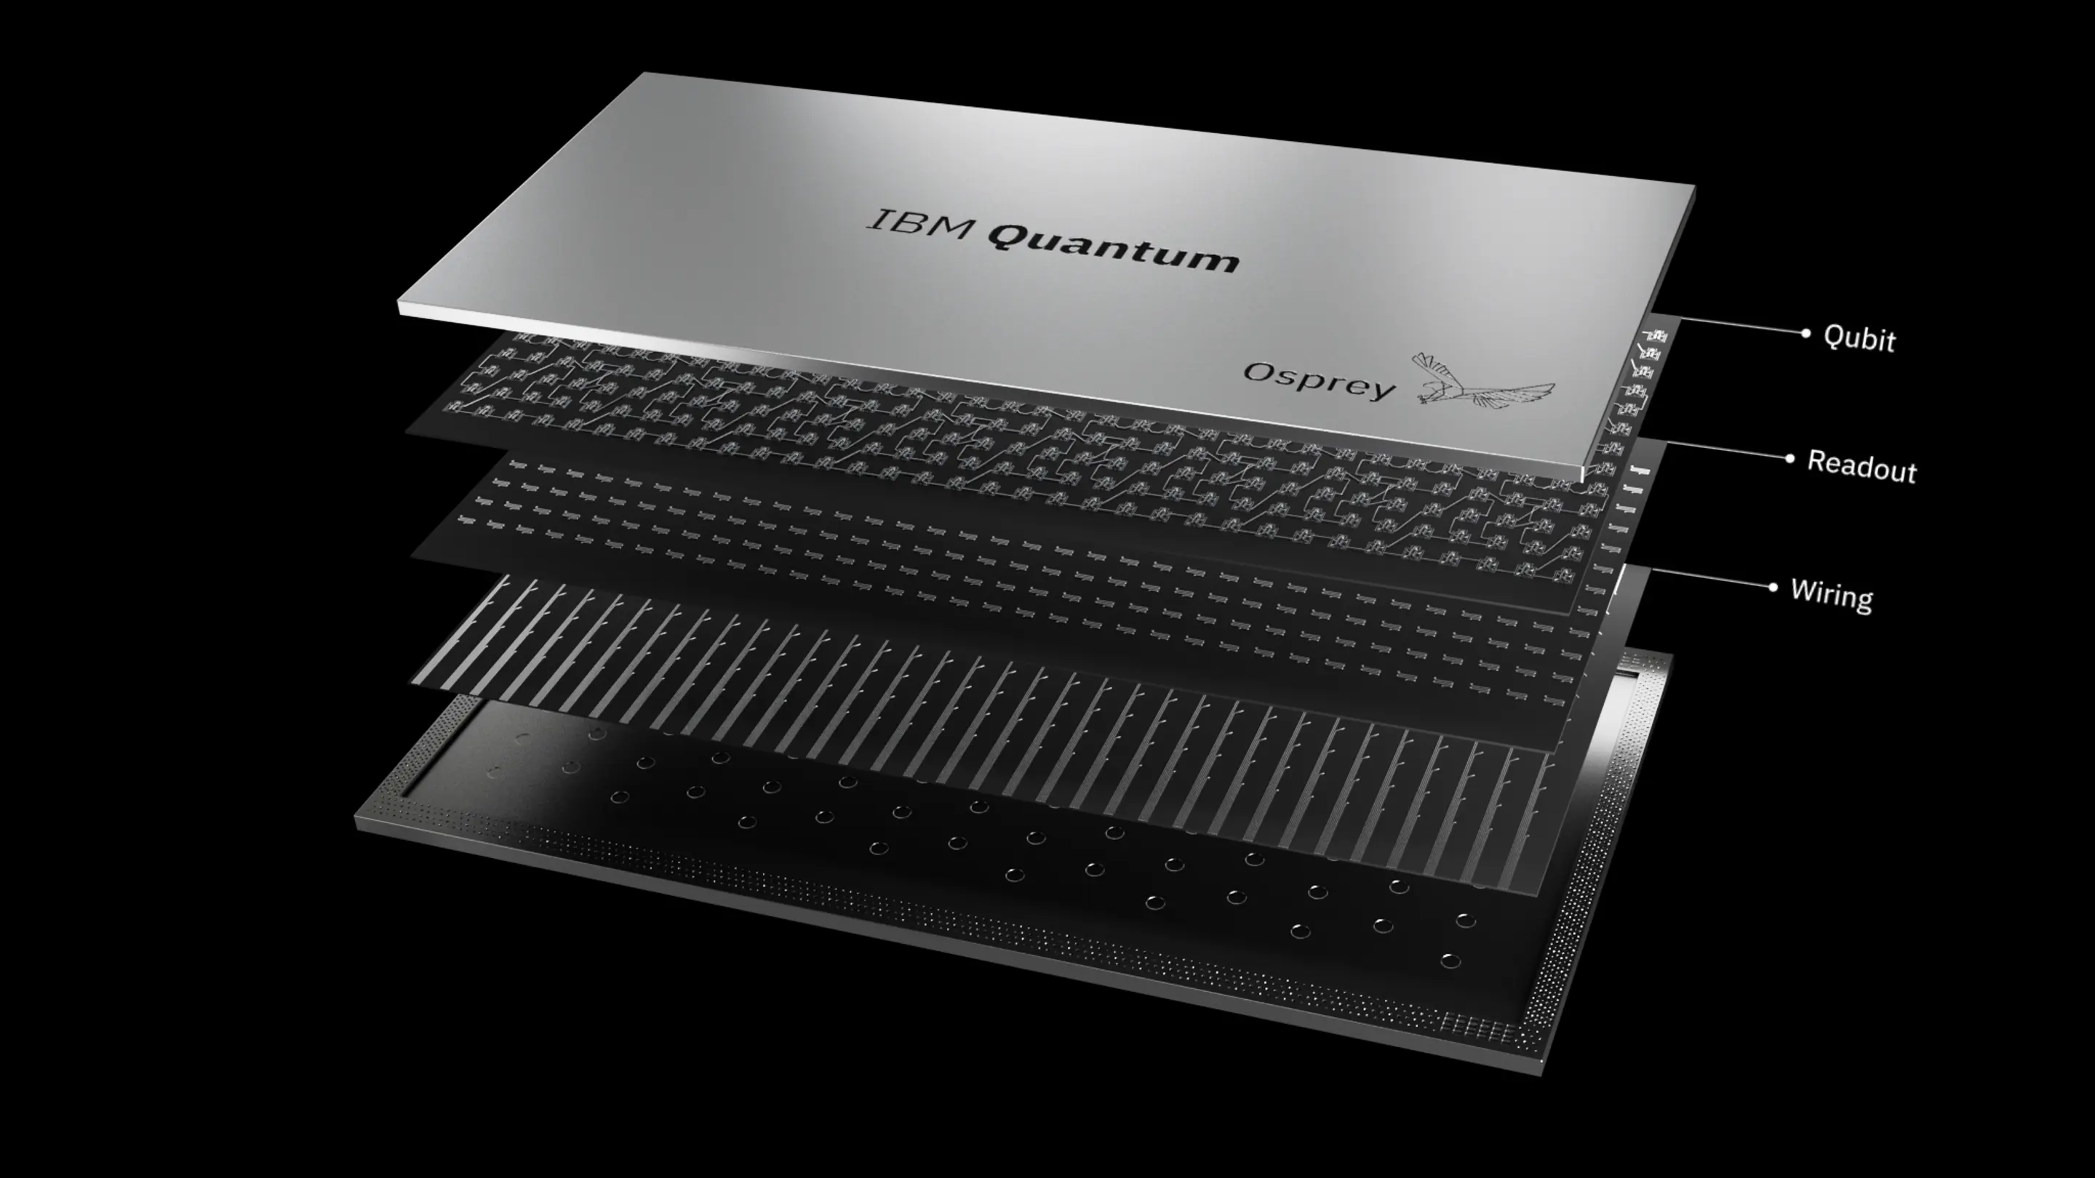
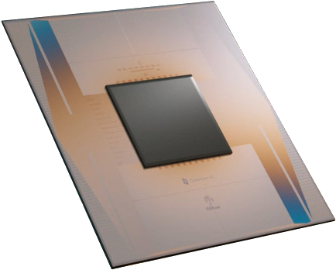
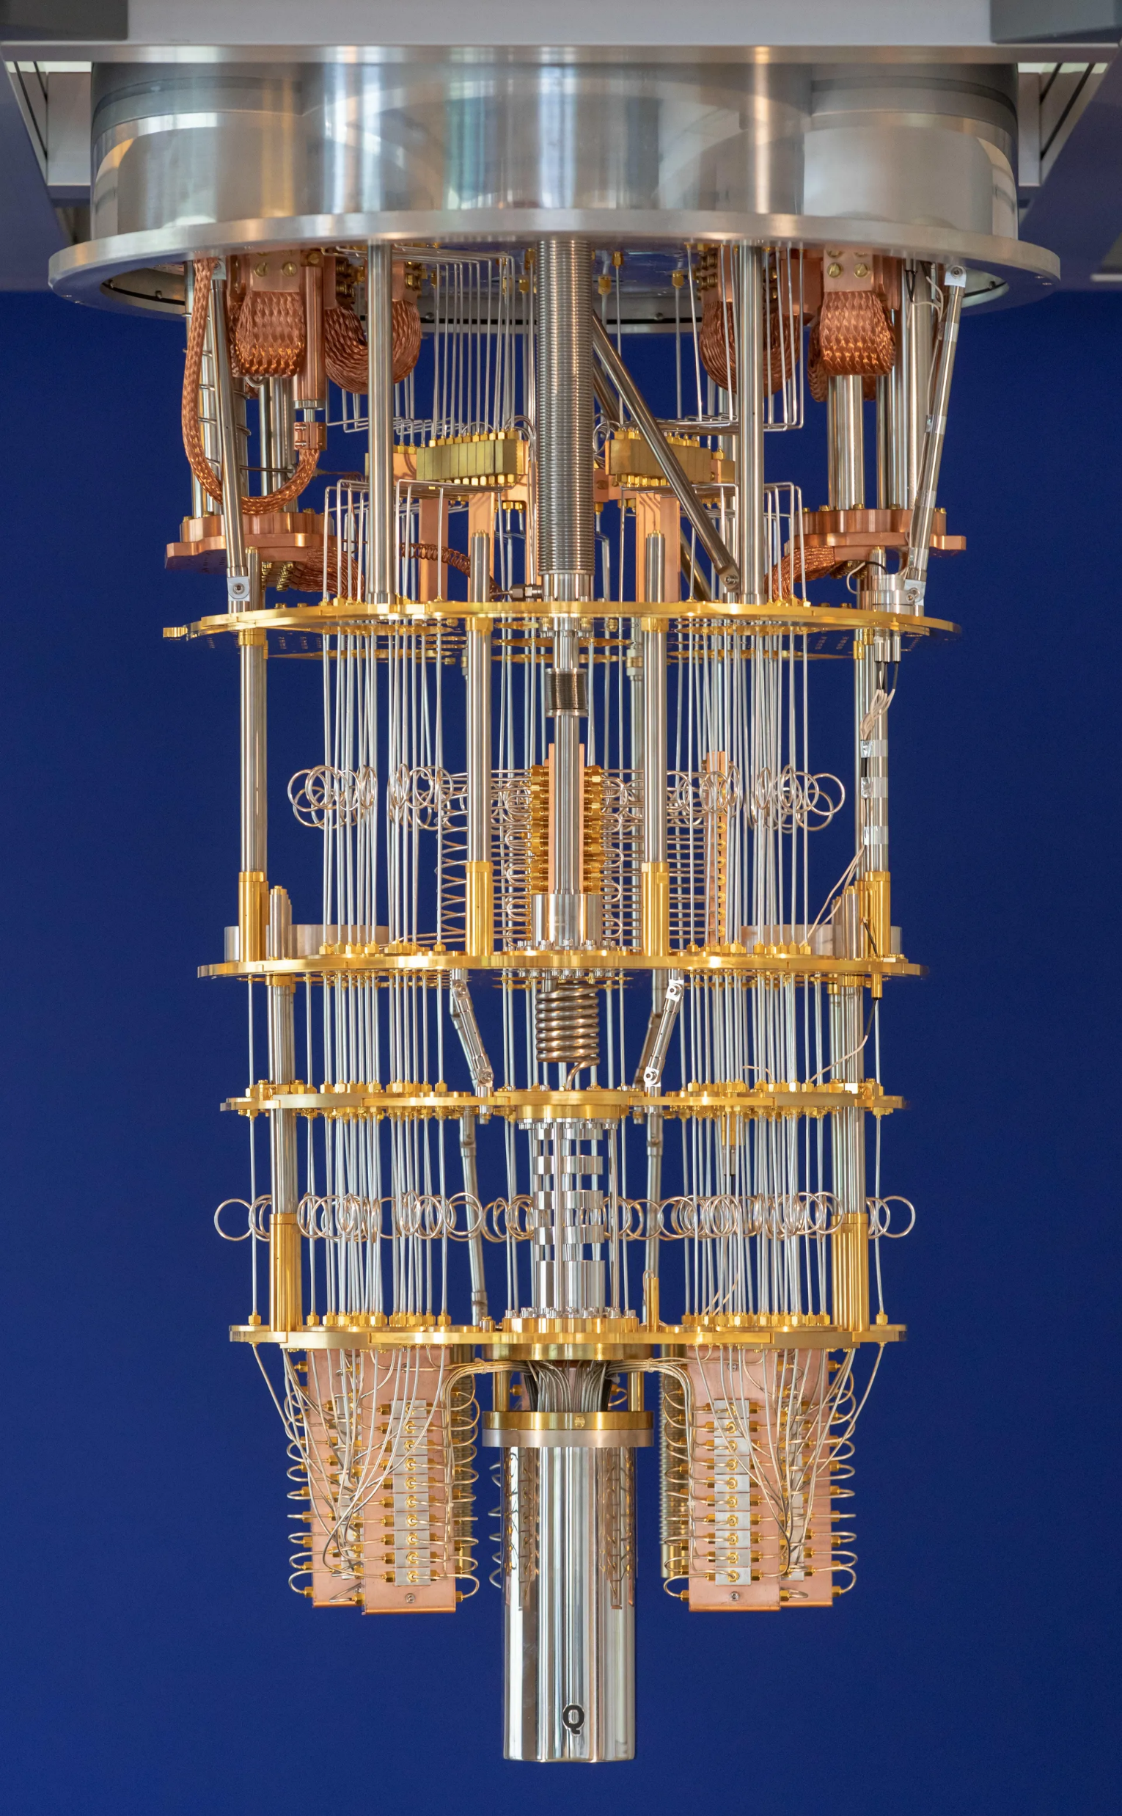
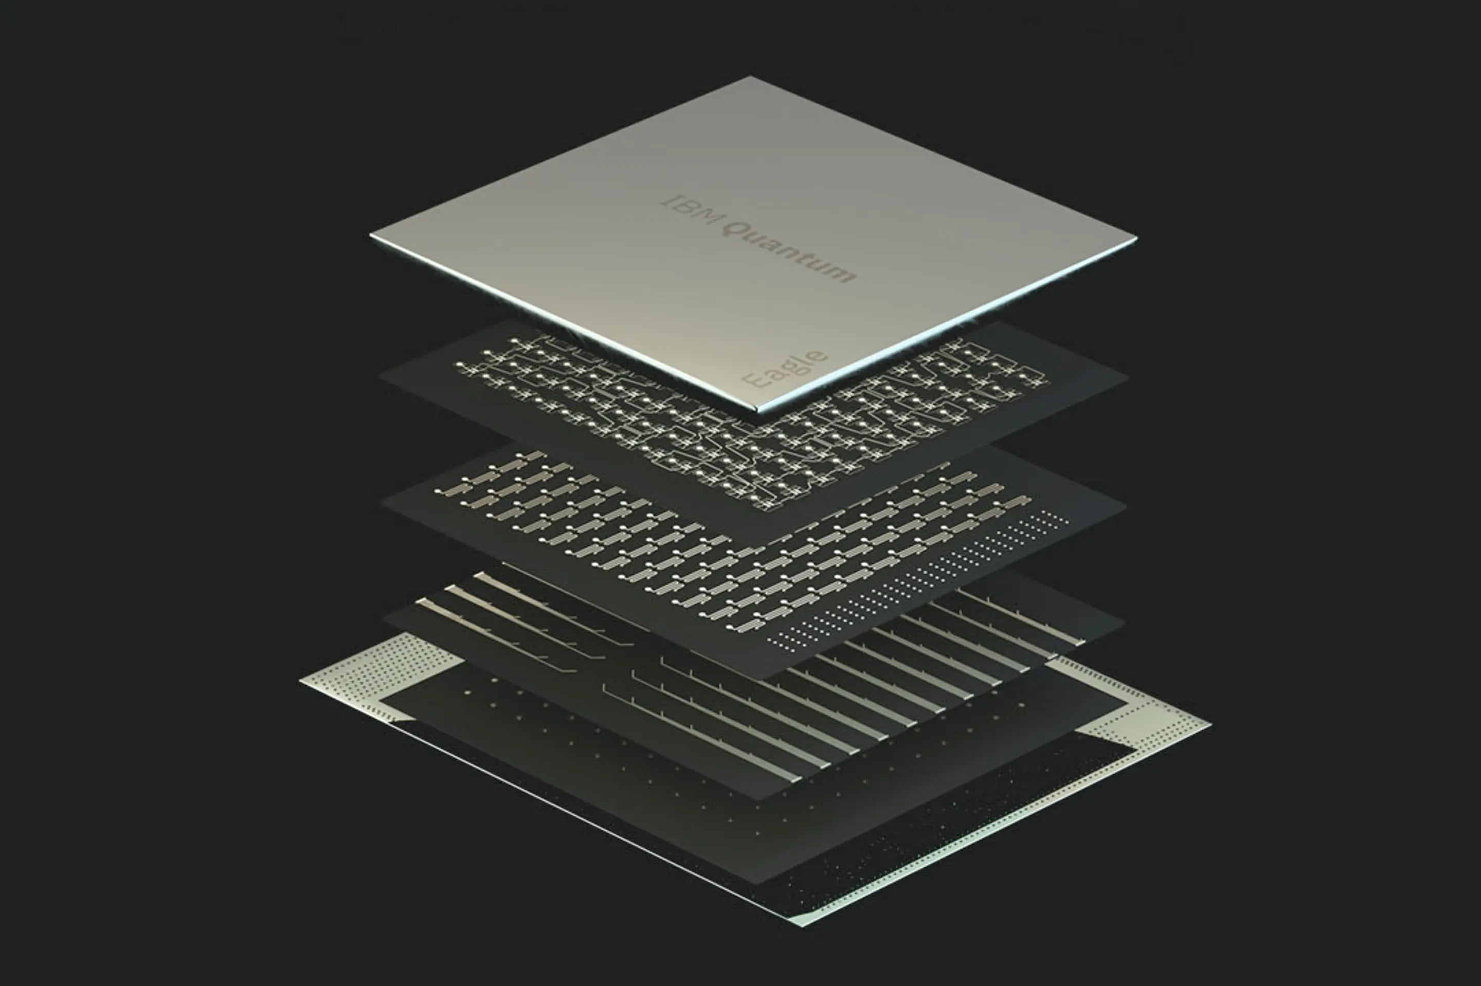
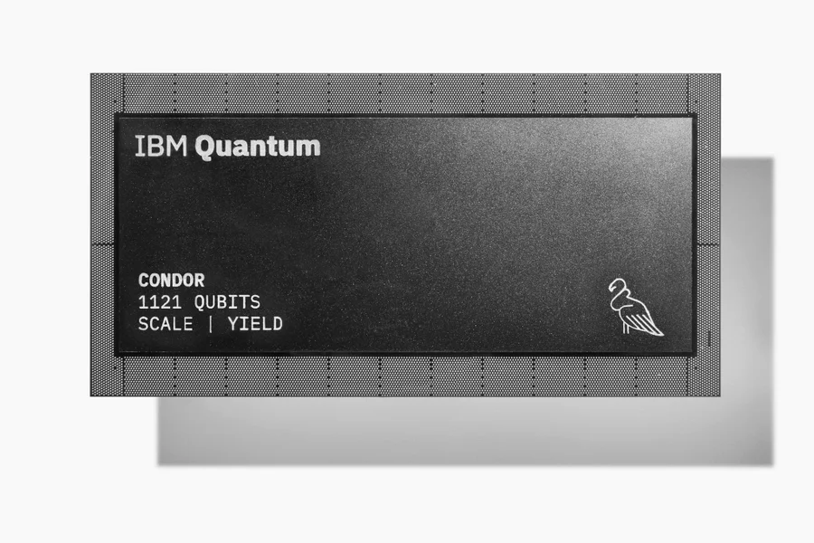
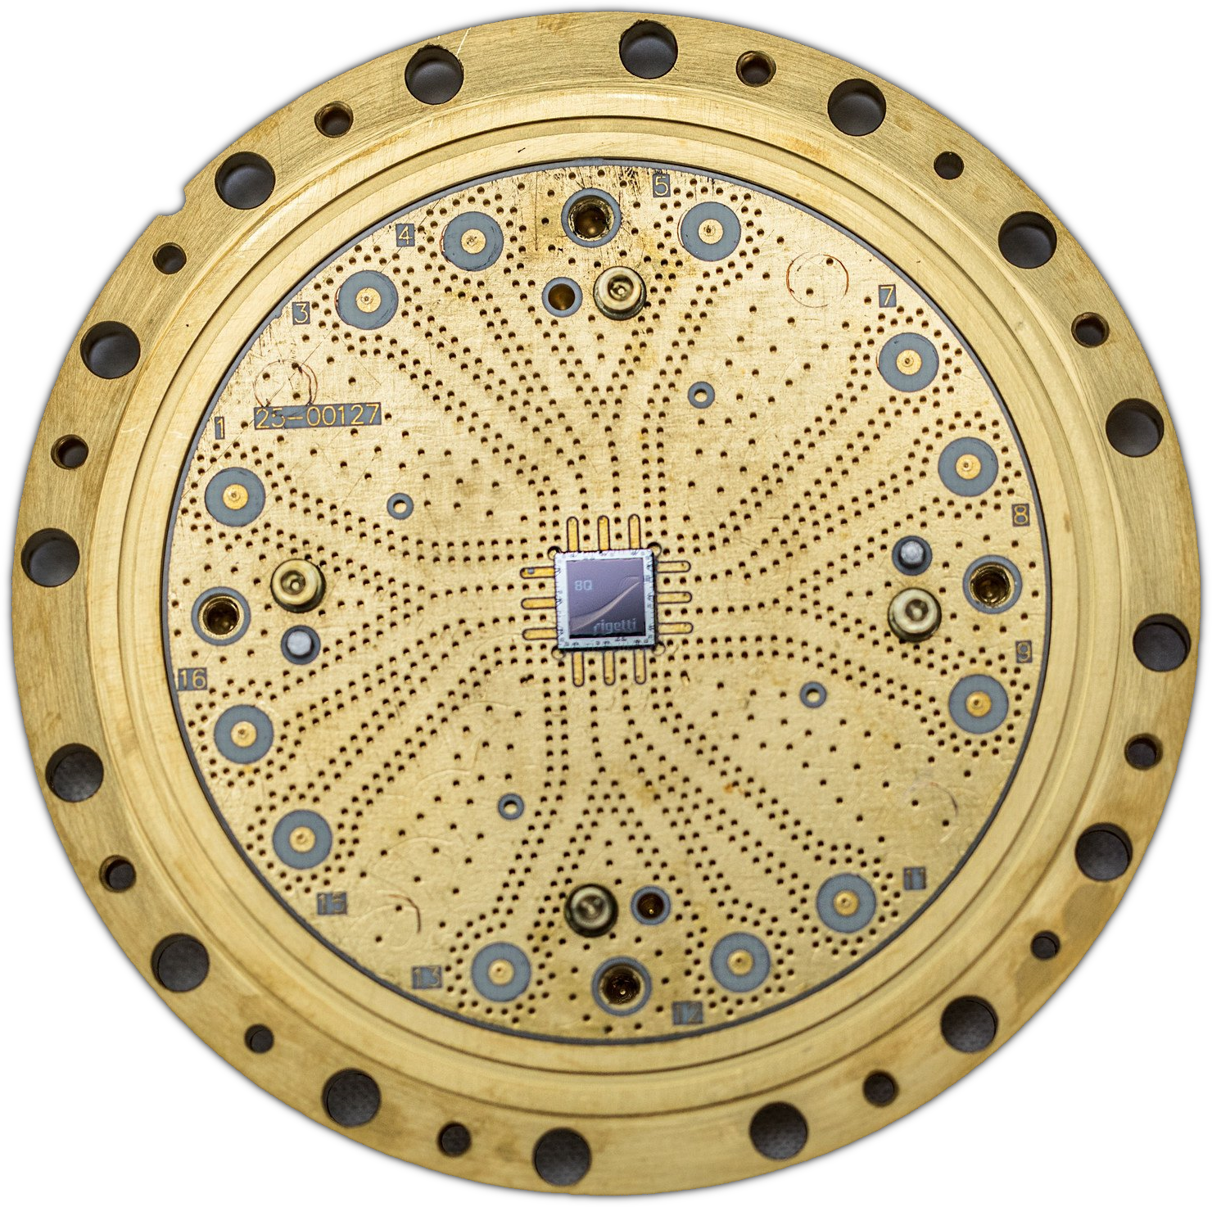
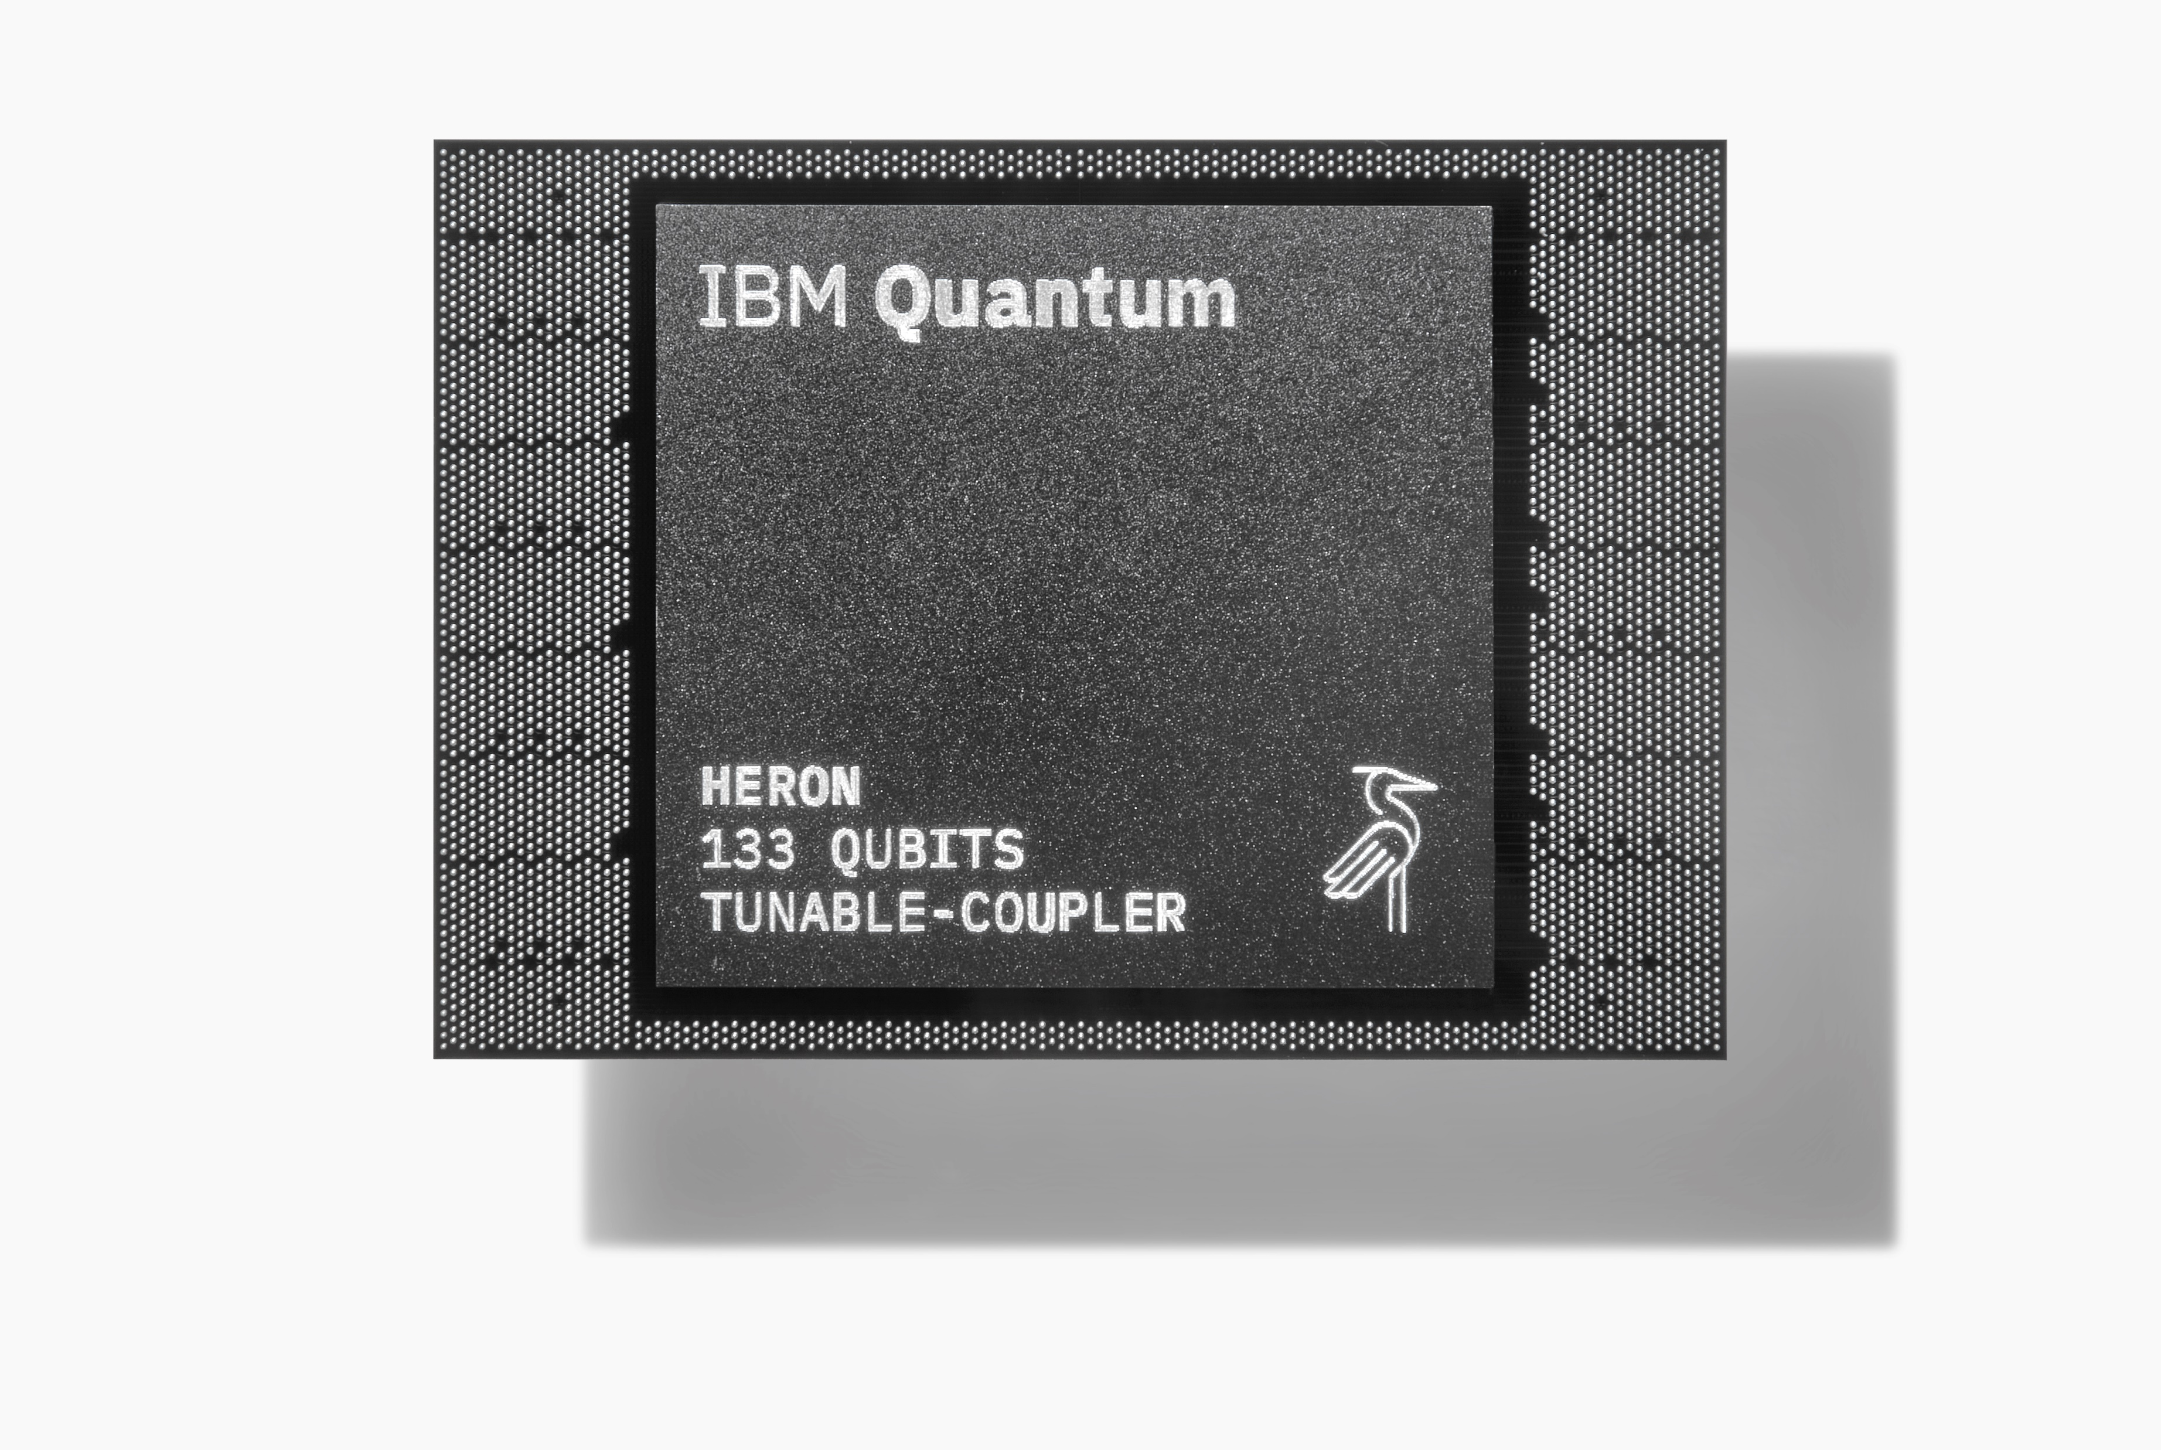
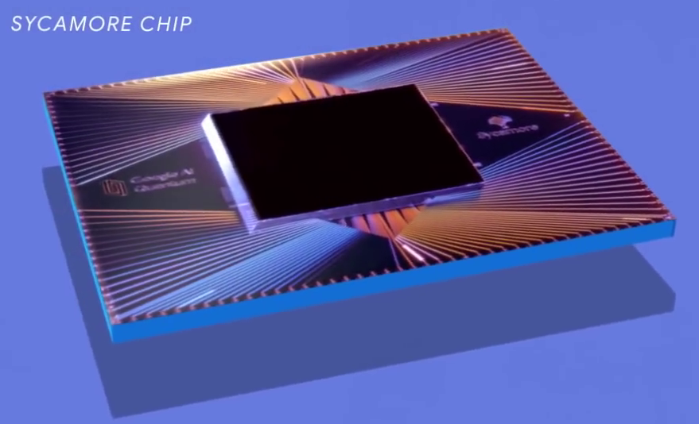
Recent Timeline of Quantum Computation
(non-exhaustive)
# of physical qubits alone is not a reliable metric
IBM Quantum System One
20 qubits
IBM Condor
1’121 qubits
Google Sycamore
53 qubits
(quantum supremacy)
IBM Eagle
127 qubits
IBM Heron (System Two)
133 qubits
Rigetti Ankaa-3 84 qubits
2019
2021
2023
2025
2020
2022
2024
IBM Osprey
433 qubits
Google Willow
105 qubits
IBM Hummingbird
65 qubits

Slide 6
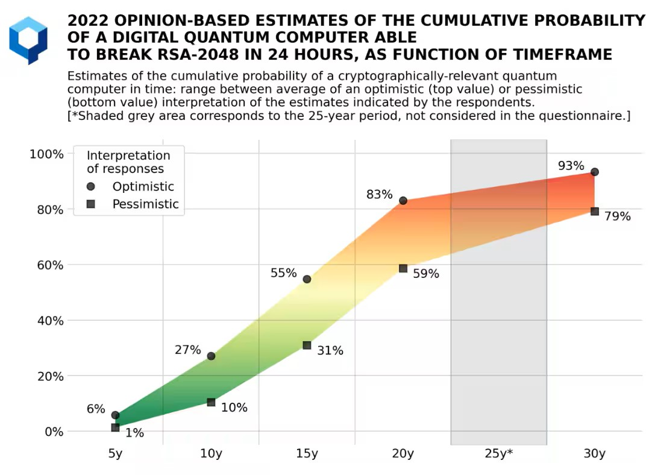
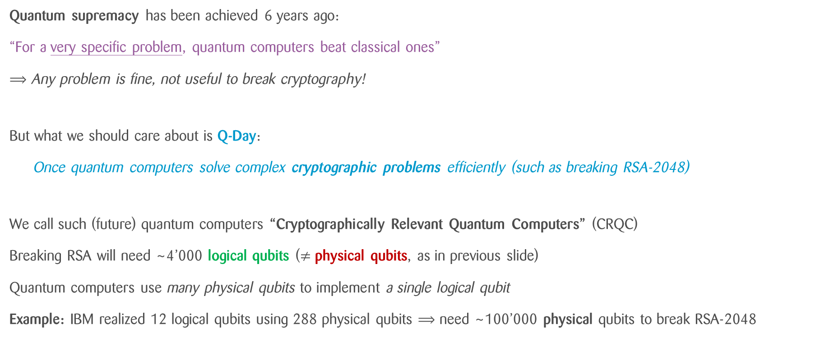
Where Do We Stand Now?
Q-Day is approaching …
Q-Day?
Quantum supremacy has been achieved 6 years ago:
“For a very specific problem, quantum computers beat classical ones”
⟹ Any problem is fine, not useful to break cryptography!
But what we should care about is Q-Day:
Once quantum computers solve complex cryptographic problems efficiently (such as breaking RSA-2048)
We call such (future) quantum computers “Cryptographically Relevant Quantum Computers” (CRQC)
Breaking RSA will need ~4’000 logical qubits ($≠$ physical qubits, as in previous slide)
Quantum computers use many physical qubits to implement a single logical qubit
Example: IBM realized 12 logical qubits using 288 physical qubits ⟹ need ~100’000 physical qubits to break RSA-2048
~2040
Notes:
Fabio

Slide 7
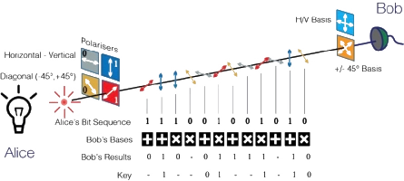
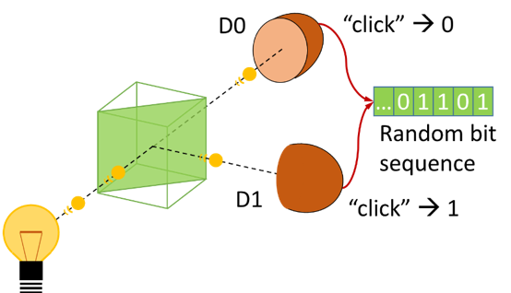
Quantum as a Blessing for Cryptography
This is Quantum Cryptography
Quantum Key Distribution (QKD)
Most secure key-exchange method:
can detect any eavesdropper thanks to no-cloning
Quantum Random Number Generation (QRNG)
Most secure way to generate randomness:
true randomness only exists in quantum physics
And more: device-independent quantum cryptography, position-based quantum cryptography, …

Slide 8
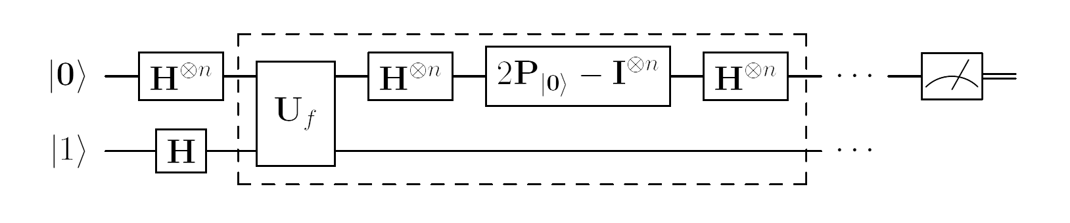
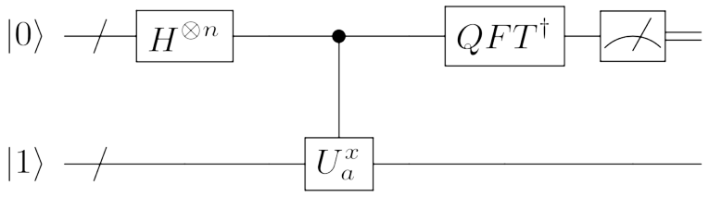
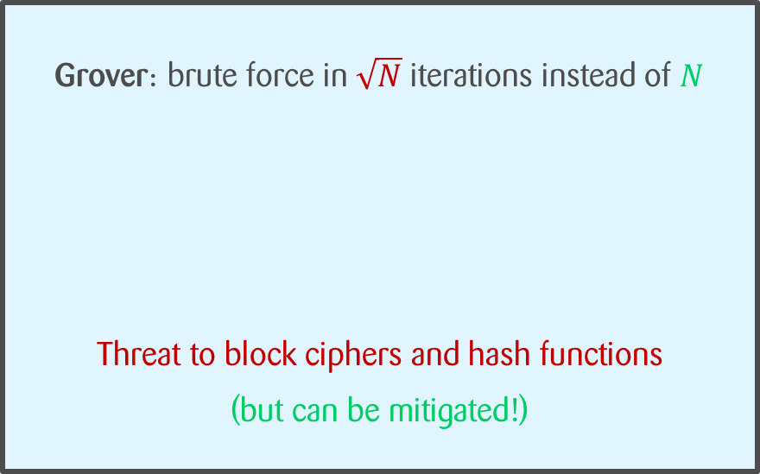
Quantum as a Threat to Cryptography
This requires Post-Quantum Cryptography
Grover: brute force in $\sqrt{N}$ iterations instead of $N$
Threat to block ciphers and hash functions
(but can be mitigated!)
Shor: solve factoring and discrete logarithm efficiently
Completely breaks DH, RSA, ECDSA, ...

Slide 9
But Why Worry Now? Harvest Now Decrypt Later!
Even if CRQC are still far away, we need to start using PQC now!
If we use weak schemes now to protect data at rest and in transit, bad actor will for sure harvest anything they can!
We need to:
Upgrade weak symmetric-key encryption (easy)
Replace key-agreement and digital signatures (harder)
How many bits need to be brute-forced to break the scheme
 | Scheme | Security level
 |  | Pre-quantum | Post-quantum
Symmetric | AES-128 | 128 | 64
 | AES-256 | 256 | 128
 | SHA2-256 | 256 | 128
 | SHA3-256 | 256 | 128
Asymmetric | (EC)DH-3072 | 128 | Broken
 | (EC)DSA-3072 | 128 | Broken
 | RSA-3072 | 128 | Broken
Double the key size!
Find new schemes!
Notes:
Fabio

Slide 10
A Paradigm Shift for
Key Agreement
Notes:
Fabio

Slide 11
A Paradigm Shift for Key Agreement
In PQC, we change the way we establish shared keys:
The classical way:
Key Agreement
Parties’ roles are symmetric
Example: ECDH (Diffie-Hellman)
The new way:
Key Encapsulation Mechanism
Parties’ roles are asymmetric
Example: ML-KEM (Kyber)

Slide 12










An Analogy
Traditional Key-Agreement (Diffie-Hellman)
New Key-Exchange Paradigm (ML-KEM)
Alice
Bob
Alice
Bob
$$=$$
$$=$$
Cannot obtain ( ) from and alone!
Cannot obtain from without !

Slide 13
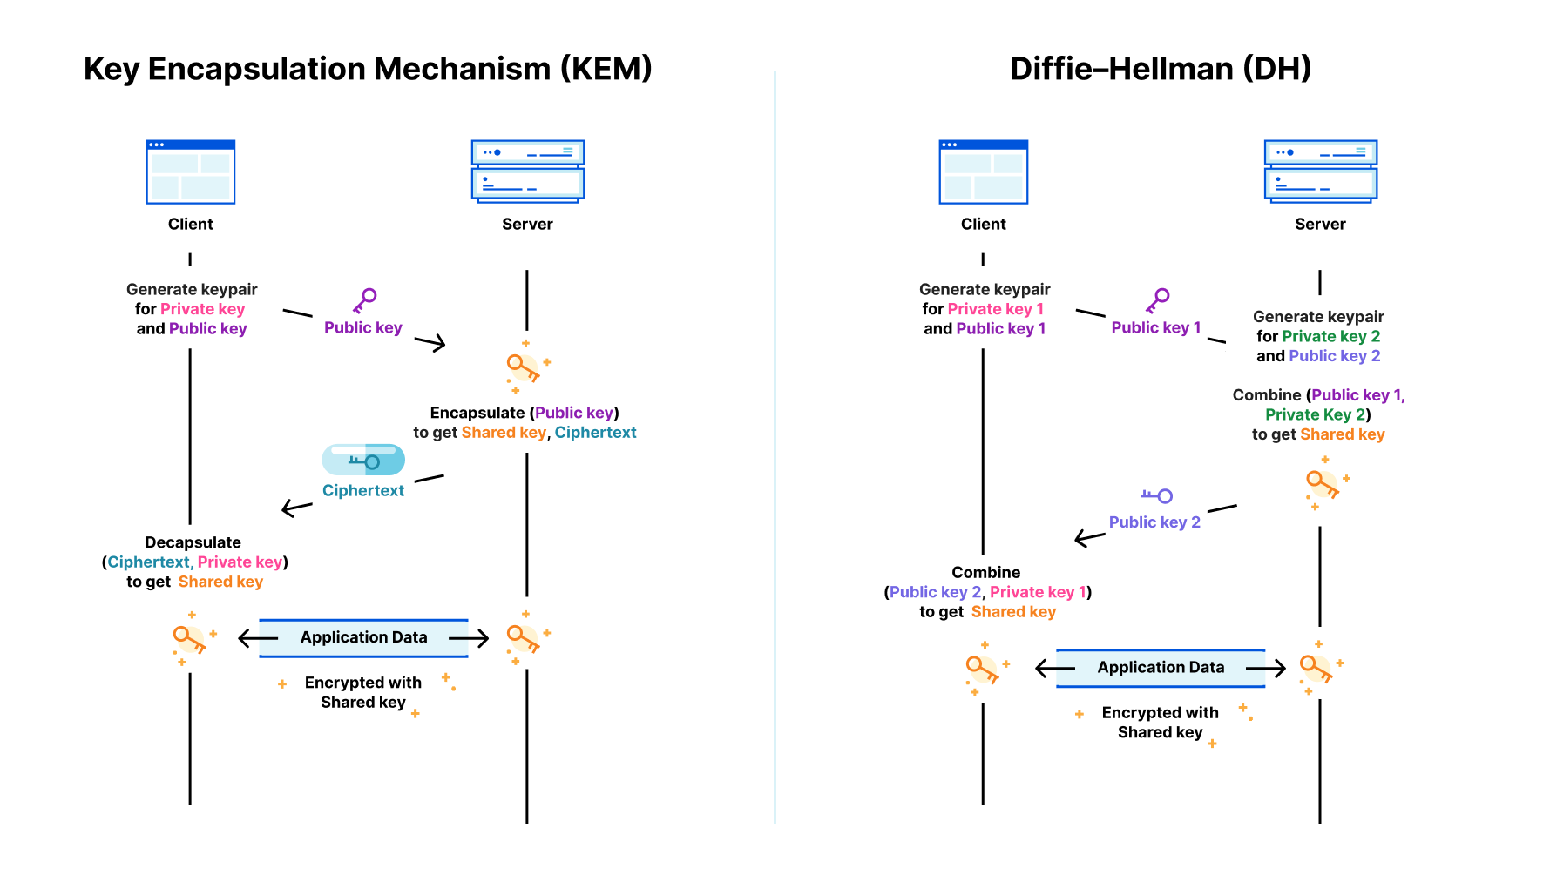
Concrete Differences
Regular DH Key Agreement
Key Agreement with a KEM
Diffie-Hellman (DH) Key Agreement: symmetric information
Client: a public key
Server: a public key
KEM-based Key Agreement: asymmetric information
Client: a public key
Server: a ciphertext

Slide 14
Standardization of
PQC
Notes:
Ben

Slide 15
Standardization by NIST
2016
2022
08/2024
03/2025
2 more algorithms selected for standardization (FIPS 206-7)
3 algorithms standardized
(FIPS 203-5)
82 Candidate Algorithms from 25 countries
Ongoing evaluation
of 2 additional sets
Notes:
Ben

Slide 16
NIST Algorithm Overview
FIPS 203
FIPS 204
FIPS 205
FIPS 206(?)
FIPS 207(?)
ML-KEM aka Kyber
KEM, used for key-exchange
Based on lattices
Standardized in 2024
ML-DSA aka Dilithium
Digital signature scheme, used in certificates
Based on lattices
Standardized in 2024
SLH-DSA aka SPHINCS+
Digital signature scheme, used in certificates
Based on hash functions
Standardized in 2024
FN-DSA aka FALCON
Digital signature scheme, used in certificates
Based on lattices
Standard almost finished
HQC
Another KEM, used as a backup for ML-KEM
Based on error-correcting codes
Standardization just started
Notes:
Ben

Slide 17
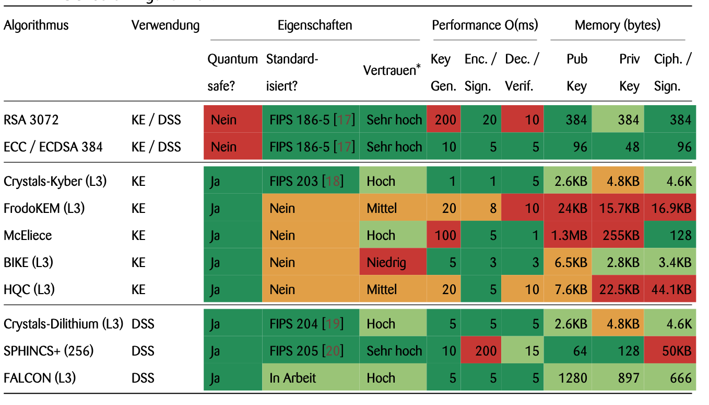
Strengths and Weaknesses of Classical and Post-Quantum Algorithms
Notes:
Ben

Slide 18
Crypto Agility
Notes:
Ben

Slide 19
What is Crypto Agility?
The primary goal of cryptographic agility is to enable rapid adaptations of new cryptographic primitives and algorithms without making disruptive changes to the system's infrastructure. Wikipedia
»
Notes:
Ben
Given that symmetric cryptography is not affected…
Key exchange and also key agreement
Digital signatures and corresponding digital certificates

Slide 20
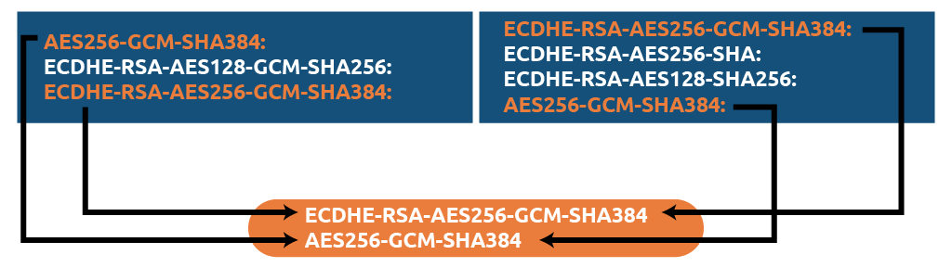
Example of Cryptographic Agility: TLS Negotiation
In the TLS handshake, the client and the server negotiate which cipher suite to use.
This is also a form of cryptographic agility! You can switch to a different cipher suite without a disruptive change.
Client
Server

Slide 21

Cryptographic Agility in the Context of PQC
Use
Classical Cryptography
#1
State
#2
State
Deploy new
Hybrid Cryptography (Classical/PQC)
Deploy new
PQC vX.Y
#4
State
#3
State
Deploy new
PQC v1.0
Notes:
Ben

Slide 22
Challenges of Cryptographic Agility at Scale
Cryptographic agility seems easy at a first glance, but is very complex at scale!
01
02
03
Visibility
Organizations often don’t have a complete picture of where cryptographic algorithms are being used.
Dependencies
Architecture or dependencies that do not foresee such capabilities, for example by using deeply integrated cryptography
Operational risk
Side-effects of switching to different algorithms / primitives must be considered and are hard to validate!

Slide 23
Cryptography Agility
Ambitious, Imperfect, Essential
Some hard thrust:
Centralized crypto control fails at scale
No single crypto library fits all environments
Agility demands awareness of crypto complexity
Why it still matters:
Partial agility enables safer PQC pilots
Early integration eases future transitions when standards finalize
Modular design now saves massive upgrade costs later
The bottom line: You won’t get crypto agility 100% right, but without it, you’ll get PQC 100% wrong!

Slide 24

Thank you!
Questions?

Slide 25
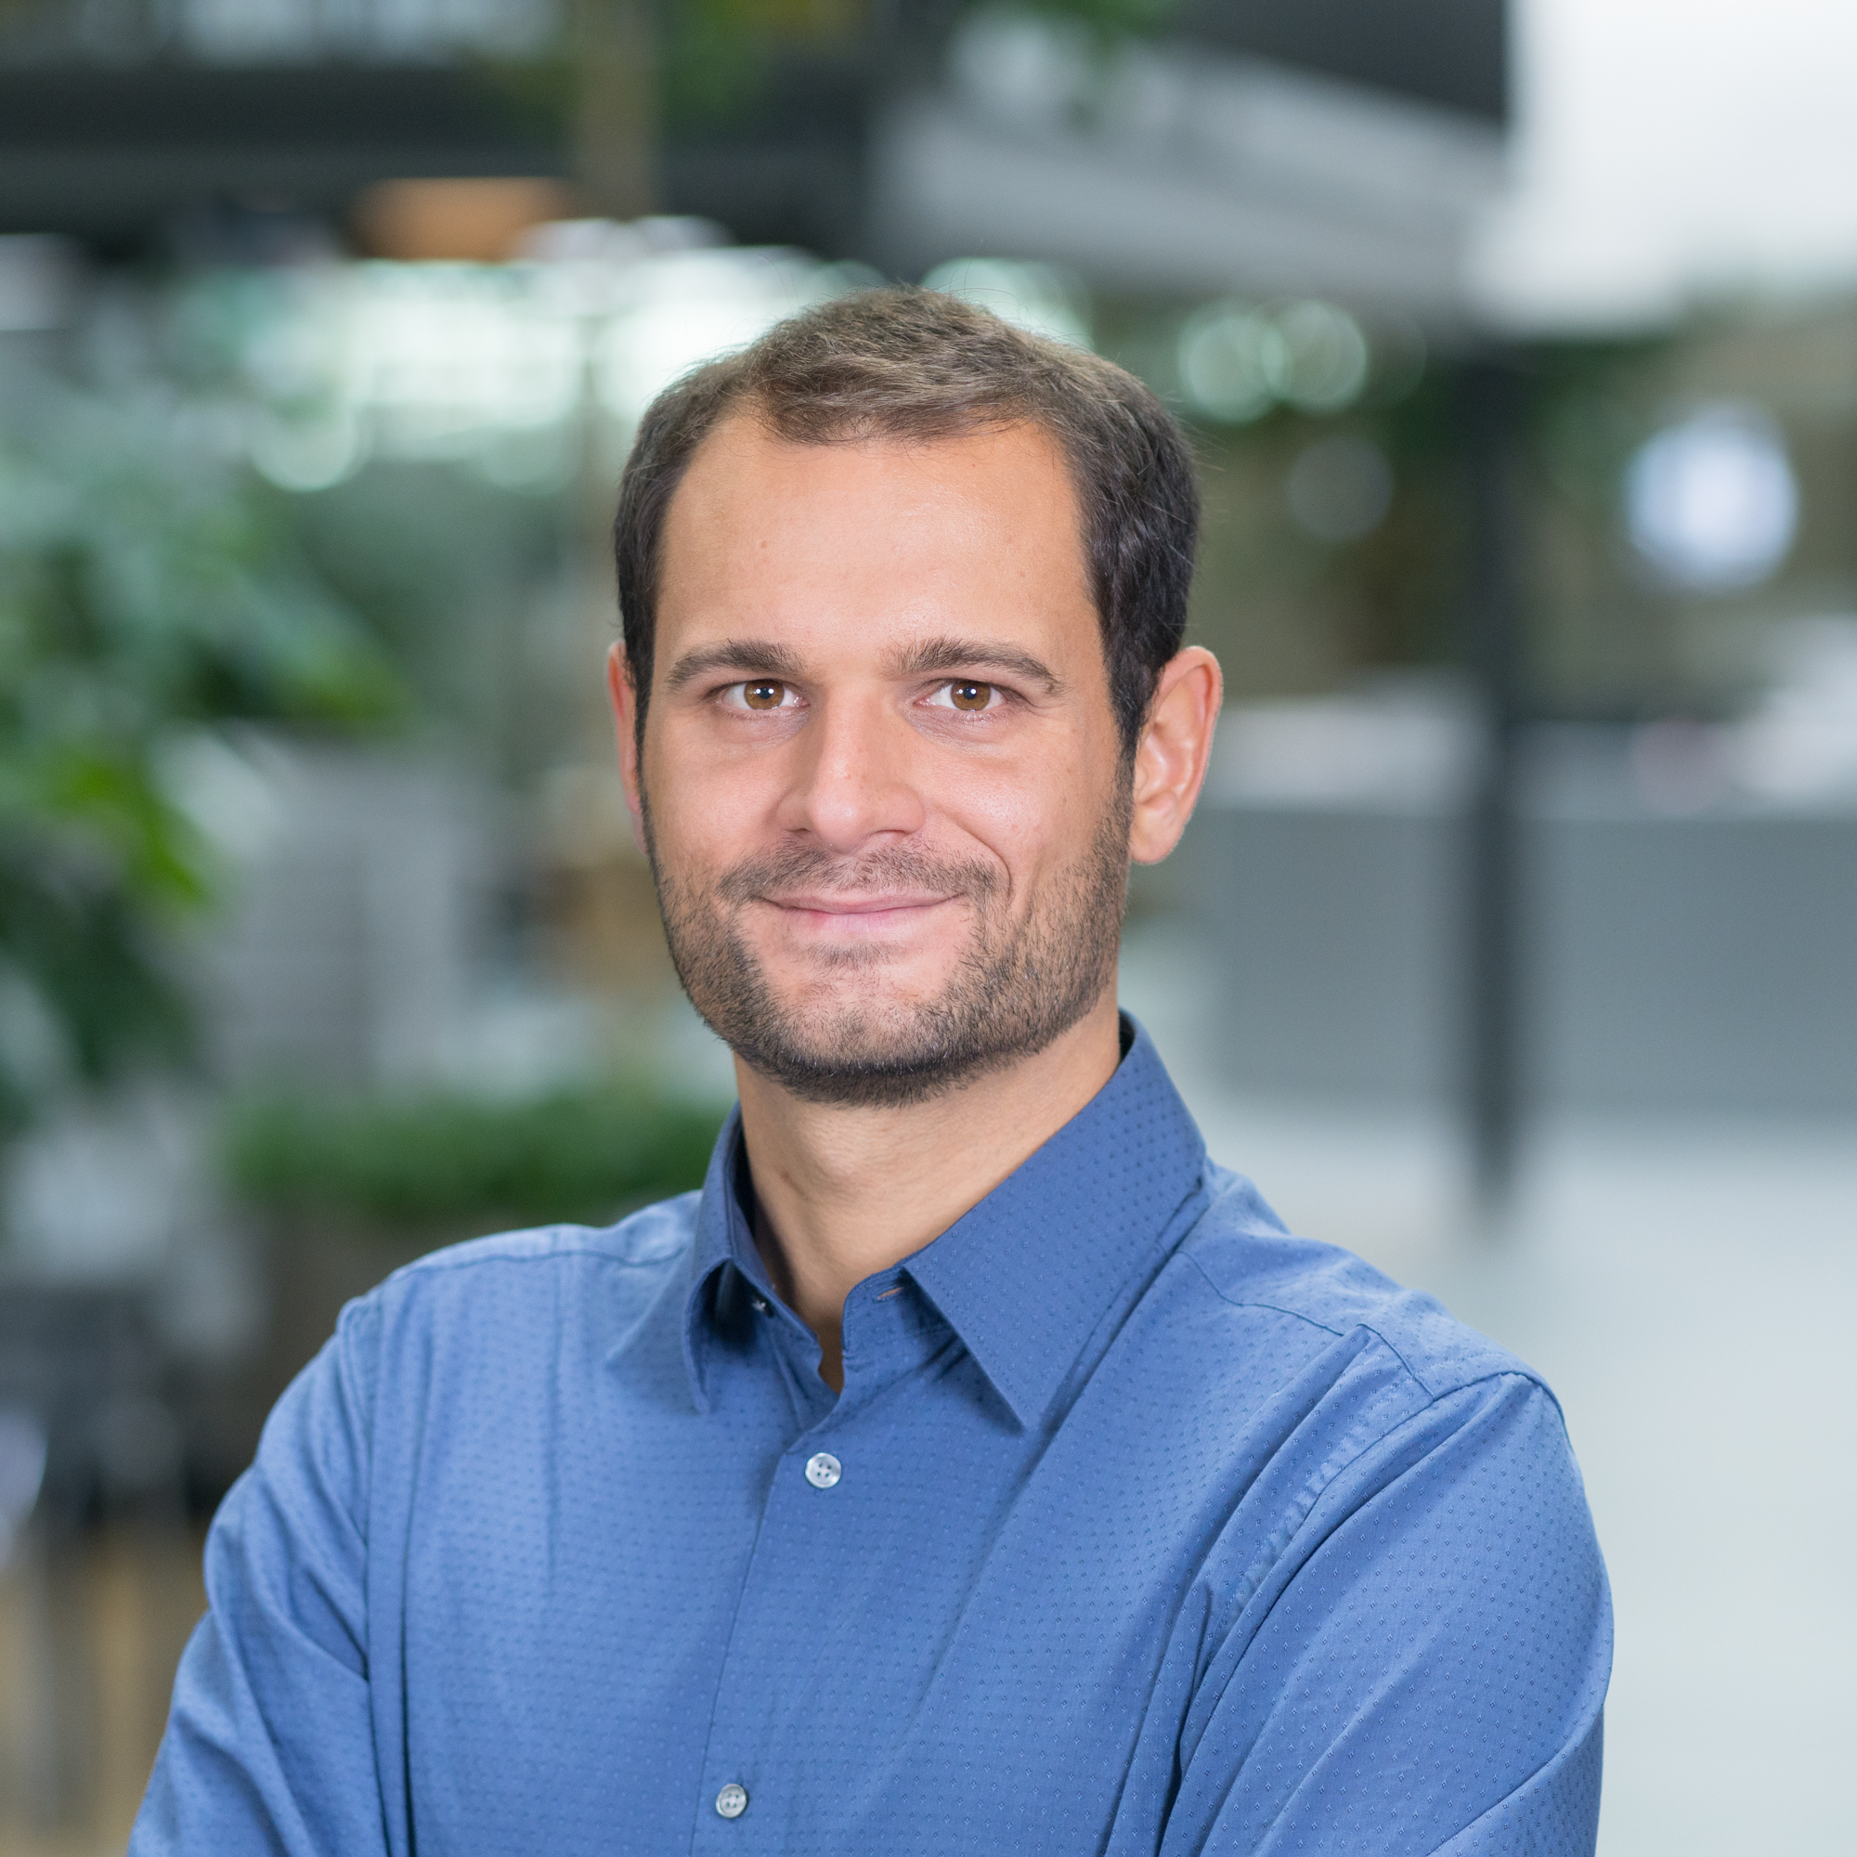

Your contact
Dr. Fabio Banfi
Expert Security Engineer
+41 43 216 65 94 fabio.banfi@zuehlke.com
Dr. Benjamin Rothenberger
Lead Security Consultant
+41 43 216 69 22 benjamin.rothenberger@zuehlke.com
Zühlke Engineering AG
Zürcherstrasse 39j 8952 Schlieren Schweiz
www.zuehlke.com

Slide 26
Appendices

Slide 27
Quantum Key Distribution (QKD)

Slide 28
Quantum Key Distribution (QKD)
Basis $+$: 0 is photon ↑ and 1 is photon →
Basis $×$: 0 is photon ↗ and 1 is photon ↘
A | random bits | 0 | 1 | 1 | 0 | 1 | 0 | 0 | 1
 | random basis | + | + | × | + | × | × | × | +
 | photons | ↑ | → | ↘ | ↑ | ↘ | ↗ | ↗ | →
B | random basis | + | × | × | × | + | × | + | +
 | photons | ↑ | ↗ | ↘ | ↗ | → | ↗ | → | →
shared secret key |  | 0 |  | 1 |  |  | 0 |  | 1

Slide 29
Post-Quantum Public-Key Schemes

Slide 30
Post-Quantum Public-Key Schemes
Mostly based on the new lattice problems
Encryption:
Public-key encryption (PKE) is less efficient than symmetric-key
For this reason, we use hybrid encryption:
1. Transmit a key using public-key encryption (PKE), or generate it with a key-exchange protocol (e.g., Diffie-Hellman)
2. Use the key for symmetric-key encryption
Nowadays, instead of PKE, we use key-encapsulation mechanisms (KEM)
Lattice-based KEMs: McEliece, NTRU, Kyber, HQC, BIKE, …
Signatures: NTRUSign, Dilithium, FALCON, SPHINCS+, …
stateless hash-based signature scheme
need to make sure withstands Grover

Slide 31
New Hard Problems on Lattices
For both classical and quantum computers
private key
ciphertext
A good basis
A random point close to a lattice point
Finding the lattice point using the good basis is easy
A bad basis
Finding the lattice point using the bad basis is hard
Infeasible in ~1’000 dimensional lattices!
plaintext
public key
This is the Closest Vector Problem (CVP), many more related problems exist: GapCVP, SVP, GapSVP, LWE, RLWE, …

Slide 32
Using PQC Signatures
Already Now in
Certificates
Notes:
Ben

Slide 33
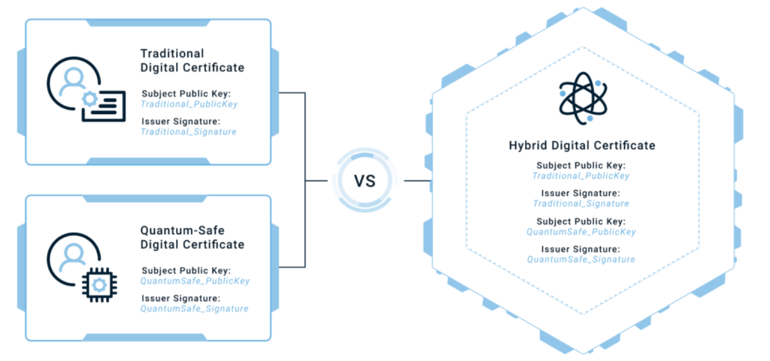
Quantumsafe Certificates
Notes:
Ben

Slide 34
Quantumsafe Certificates
How can you combine a classical signature with a PQC signature?
Approach 1: Hybrid Certificates
Extensions for certificates
Alternative key, alternative signature algorithm
Alternative signature
Simple
Standardized as X.509 Alternative Keys
Approach 2: Chameleon Certificates
Base certificate (classic crypto)
Delta certificate (PQC)
Base certificate contains a “descriptor” extension
Delta certificate can be derived from the base cert. and the descriptor
Approach 3: Composite Certificates
Combine multiple signatures into a single construct.
Validation can be implemented as:
valid even if one of the signatures is broken (OR-based)
valid only if all signatures are valid (AND-based)
No backwards compatibility
Approach 4: Merkle Tree Certificates
Store certificates in a Merkle hash tree
Typically: as part of the Certificate Transparency (CT) logs
Countermeasure to the large signature sizes
Connection to CT log is required for verification
Notes:
Ben -> Ask about deep dive?

Slide 35
Migration to PQC

Slide 36
Our Approach to PQC Migration
When migrating to PQC, we typically divide the migration into technical and organizational aspects.
»
Notes:
Ben
Given that symmetric cryptography is not affected…
Key exchange and also key agreement
Digital signatures and corresponding digital certificates

Slide 37
Technical Migration to Post-Quantum Cryptography
Phase 1:
Discovery
Phase 2:
Evaluation
Phase 3: Priorization
Phase 4:
Roadmap & Planning
Collecting an inventory of critical data (incl. its expected lifespan)
Inventorying of all cryptographic mechanisms and technologies
Cryptoagility of system components and applications
Quantum risk for IT- systems (incl. current operational risks)
System prioritization for replacement measures (short-term, medium-term, long-term)
Establishing a roadmap and process for the transition to PQC. This is important for budget allocation.
Technical inventory
Quantum risk report
Prioritized list of systems
Roadmap for migration

Slide 38
Phase 1: Collection of Critical Data
1. Data source
2. Classification
3. Protection requirements
4. Measures
Creation of a data catalog by collecting all known data sources:
Databases
Cloud storage
Email server
Backups
…
Classification of all data according to criticality criteria:
Sensitivity
Scope
Regulatory requirements
Service life
For data that is classified as critical, the level of protection required must be determined, e.g:
Confidentiality
Integrity
Authenticity
…
For all critical data, determine which cryptographic algorithm is currently used to achieve the selected level of protection:
AES-256-GCM
HMAC
Continuation: Focus on critical data

Slide 39
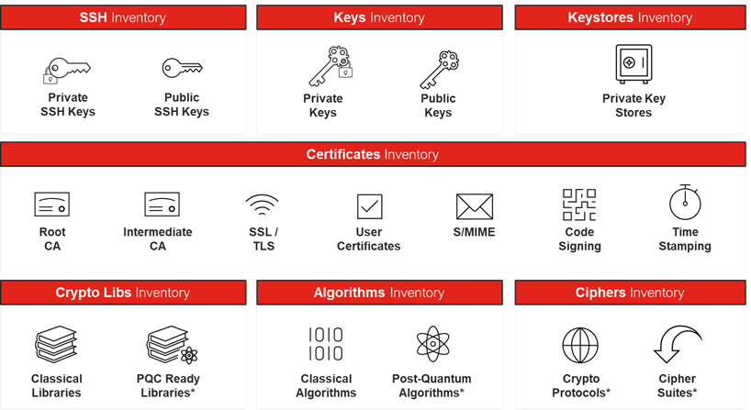
Phase 1: Inventory of Critical Data and Cryptographic Mechanisms

Slide 40
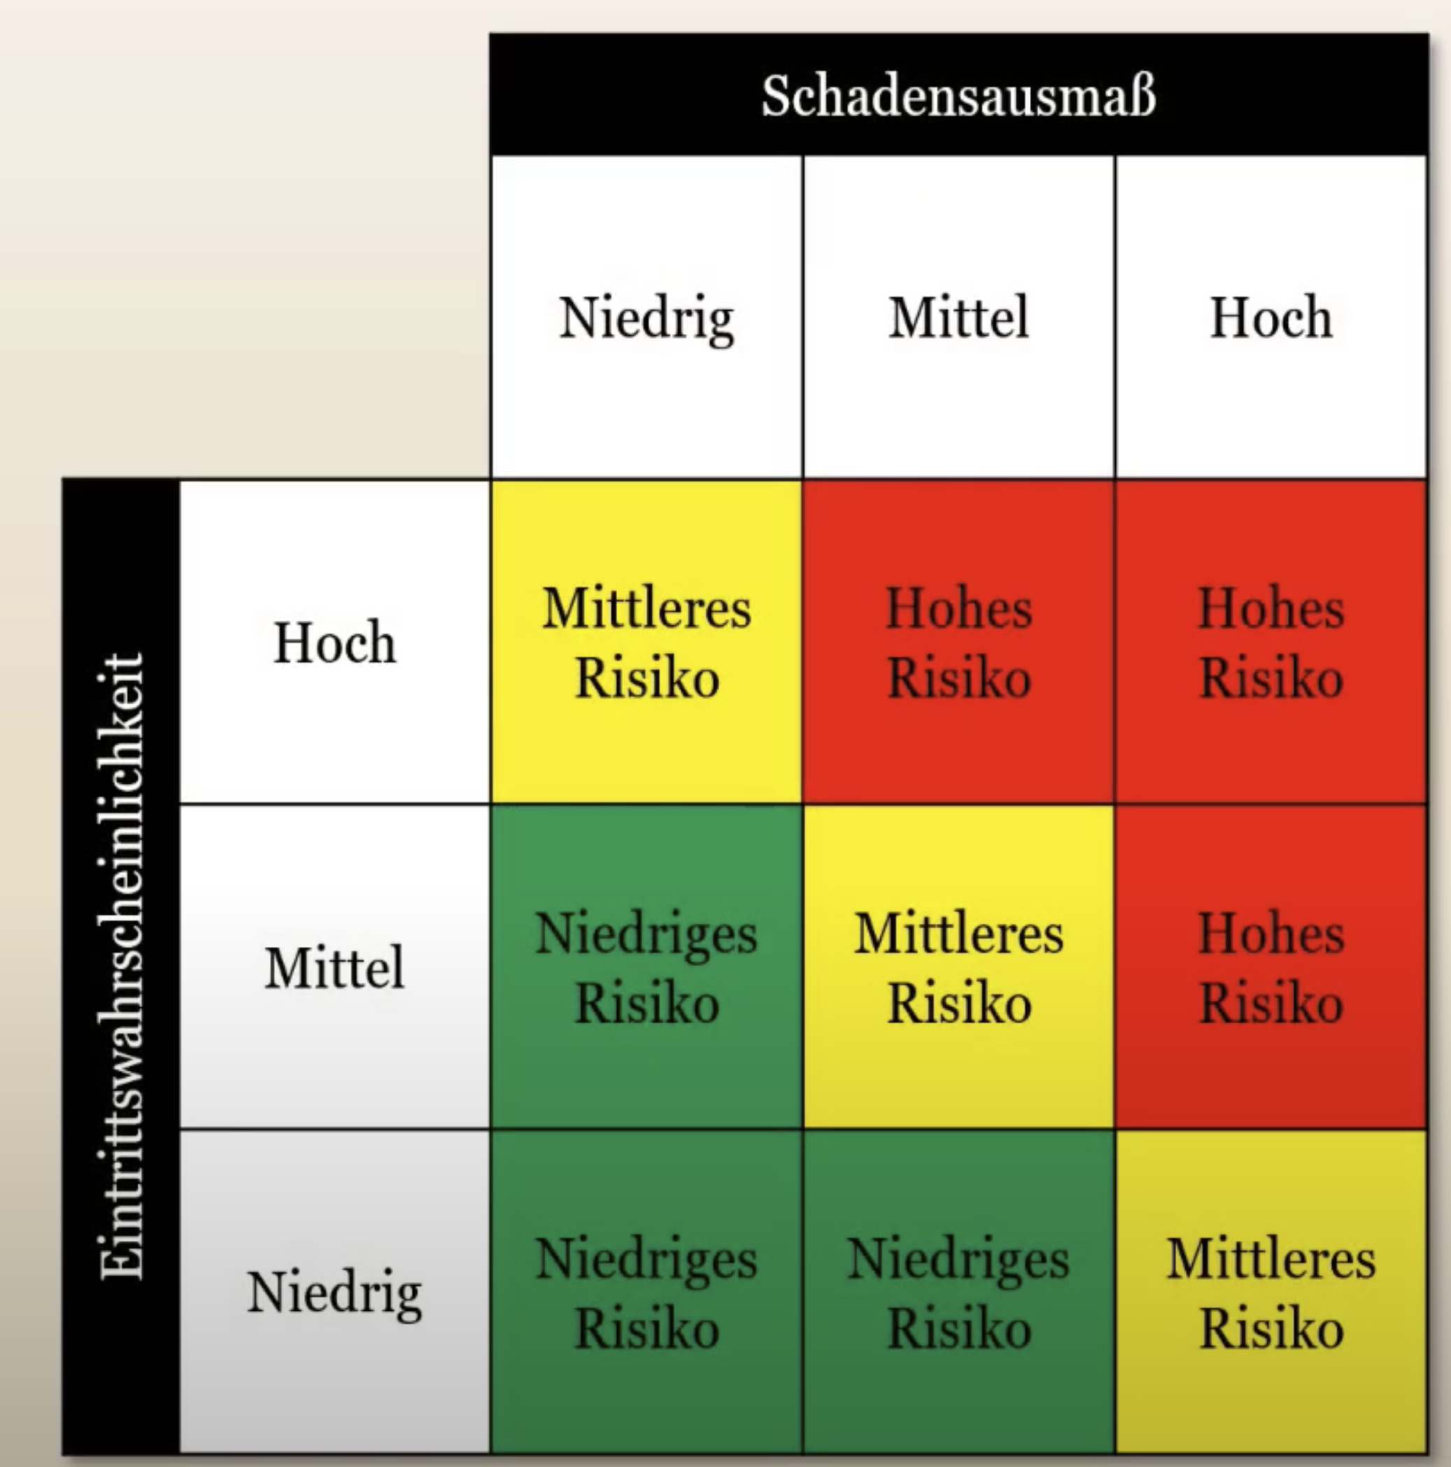
Phase 2: Evaluation of Quantum Risk and Crypto-Agility
Systematic approach based on the results of the inventory
How high is the risk of “Harvest Now, Decrypt Later” attacks?
What is the lifespan of critical data?
Do they have “external contact” (e.g. transmission via the Internet)?
Risk Matrix
How high is the risk posed by quantum computers in the future (Q-day)?
How agile is the IT architecture for the switch to post-quantum cryptography (PQC)?
Which regulatory and business requirements must be met (e.g., DORA, NIS2)?

Slide 41
Phase 3: Priorization
Short-term measures with high priority
Measures to defend against “harvest now - decrypt later” attacks.
Increasing the size of symmetric keys (e.g., AES-256)
Medium-term measures with medium priority
Measures to migrate cryptography in view of the “Q-Day”.
Use of hybrid certificates.
Long-term measures with low priority
Measures that are useful for achieving a post-quantum target architecture. Impact on long-term roadmap.

Slide 42
Phase 4: Roadmap & Planning
 |  |  |  |  |  |  |  |  | expected Q-Day
 |  | 2024 |  | 2026 |  | 2028 |  | 2030 |  | 2032 |  | 2034 |  | 2036 |  | 2038
Priority 1
Priority 2
Priority 3
Start of inventory, increase symmetric key size
Realization of hybrid TLS key exchange, shorten certificate life time
Migration of first partner to hybrid crypto profile
Migration of remaining partners to hybrid crypto profile
Realization of hybrid certificates
Migration of first partner to hybrid certificates
Migration of remaining partners to hybrid certificates
Optimization of cryptographic agility
Notes:
Benjamin

Slide 43
Organizational Migration to Post-Quantum Cryptography
Consideration of the principles of cryptographic agility for future-proof security (incl. strong governance and controls)
Hardware and product procurement planning
Adaptation of hardware and product procurement requirements („Future Inventory“)
Obligation to use hybrid cryptography
Parallel use of classic and PQC algorithms to ensure compatibility
Extension of the Crypto-Governance
Expansion of crypto governance for PQC through secure architecture components, design patterns, and libraries.

